Slide 1

Department of Electrical and Computer Engineering
Electric Power Research Center

Slide 2
Electric Vehicle Charging Data Analysis and Grid Impact Assessments
This work was funded by the Iowa Energy Center project "Mining Smart Meter Data for Modeling and Mitigating EV Charging Impacts on Distribution Grids.”

Slide 3
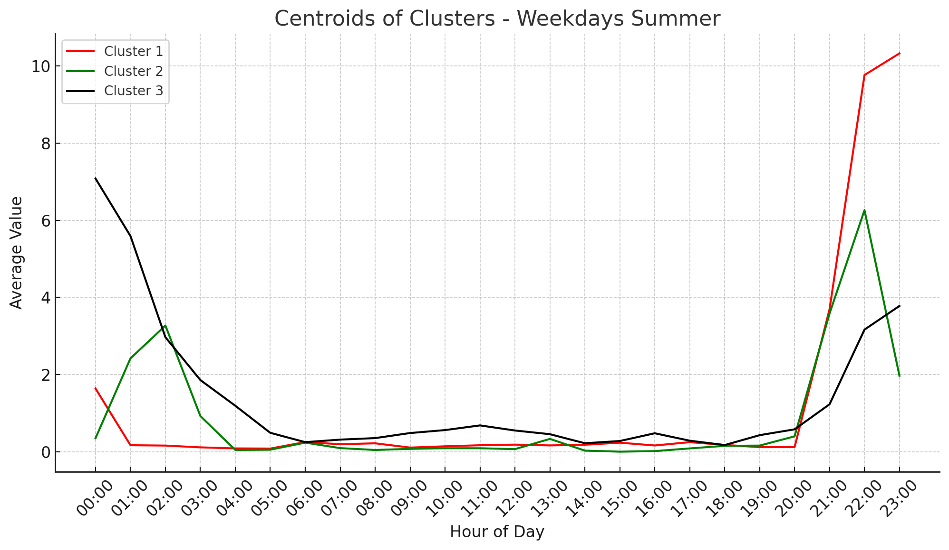
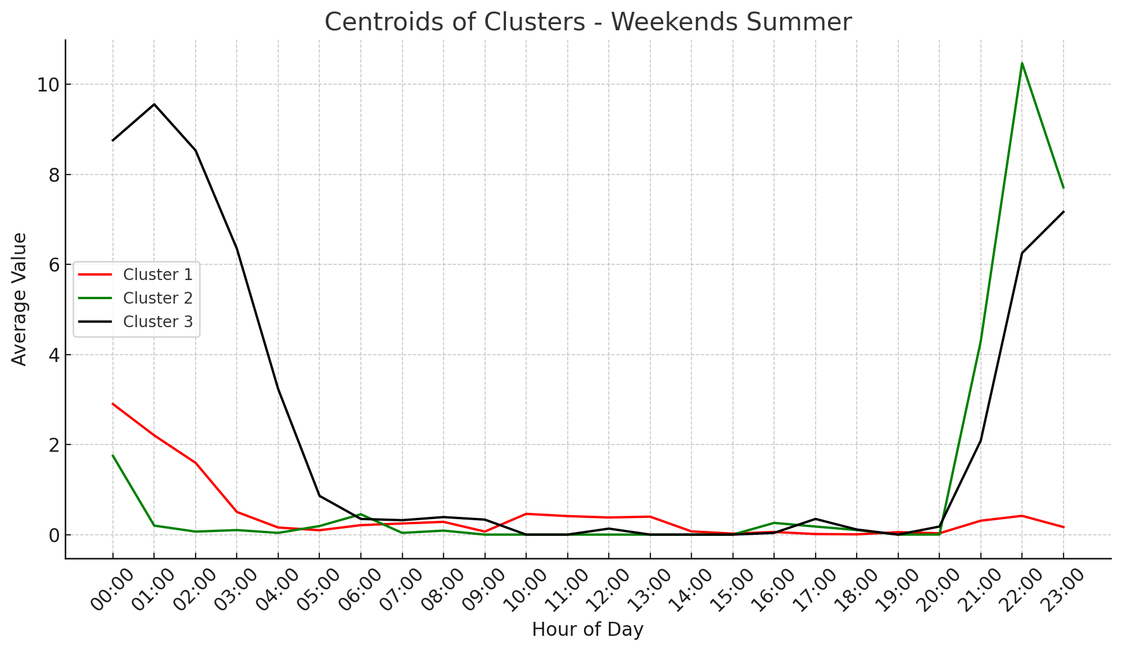
DT Health Assessment with EV and Heat Pump
Quantify impacts and simulate load conditions for increased EV and heat pump penetration.
Develop an open-source tool for utilities to assess transformer loading conditions and EV hosting capacity.
Utilize advanced machine-learning techniques and time-series analysis of real EV and heat pump data from various chargers and climates.
Explore EV charging behavior variations between seasons and compare behavior between workdays and weekends.
Data segmentation and clustering for seasonal pattern analysis and representative load profile extraction.
Cluster | Probability | Customers
0 | 0.8015 | 1519
1 | 0.1985 | 377
Cluster | Probability | Customers
0 | 0.242 | 461
1 | 0.085 | 160
2 | 0.644 | 1219
3 | 0.0299 | 56
Fig. EV charging clusters for summer weekdays and weekends
https://www.linncountyrec.com/application/files/7116/7821/0293/2023_Rate_Summary_Sheet.pdf
Notes:
In this slide, we expand our analysis to include the impact of both EVs and heat pumps on distribution transformers.
Quantify impacts and simulate load conditions for increased EV and heat pump penetration.
In this context, we used advanced machine-learning techniques to segment and cluster data for seasonal pattern analysis, which helps in extracting representative load profiles. (explain what is clustering)
For heat pump, we clustered seasonally. For EV, we clustered both seasonally and by weekdays and weekends (explain why).
Top two figures: Typical heat pump load shape in summer and winter. 2 clusters for summer and 4 clusters for winter, this number is determined by an algorithm. Probability and customers represent the frequency of the profile that appeared in the dataset. As you can see, the load for winter is nearly tripled than summer. This is because of the electric heat efficiency. But note that the probability is low.
Bottom two figures: compare the charging patten across weekdays and weekends during summer. Due to space, there are no other seasons, but the results show variations across different seasons.

Slide 4
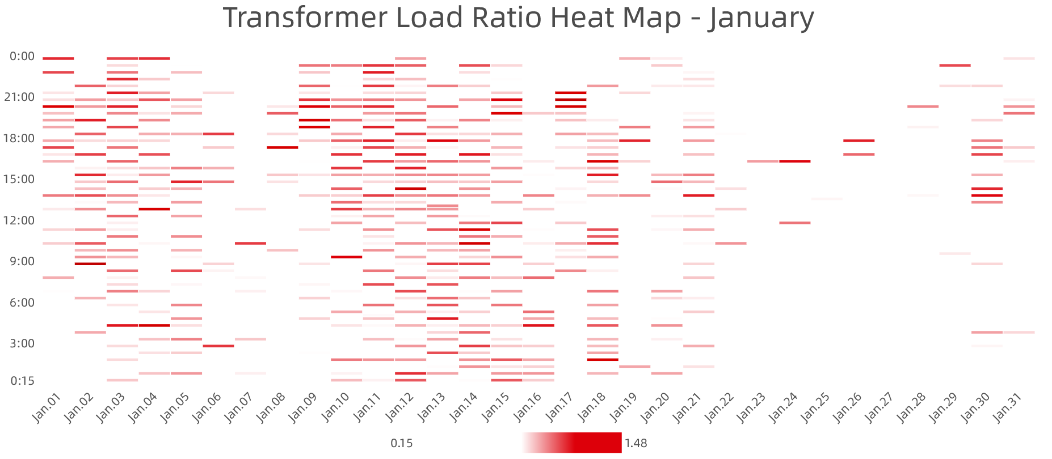
DT Health Assessment with EV and Heat Pump
Use Monte-Carlo Simulation and sample the heat pump and EV charging profiles using the extracted seasonal typical curves with different penetration levels of both EVs and heat pumps. Calculate the final aggregated load for each customer with corresponding smart meter data.
Integrate aggregated load with utility models considering transformer-customer connectivity to calculate the distribution transformer loading condition and evaluate overloading duration and intensity.
Open-source tool for utilities to evaluate DT loading and grid planning with future EVs and heat pumps using any data.
Fig. Loading ratio heat map of specific transformer in a month
Notes:
This is an ongoing work utilizing the processed data.
Top Figure is the transformer load ratio heat map in one month. We are going to do the same thing for every transformer, and Simulate with different penetration levels. Each season will use the corresponding seasonal load shape.
This will calculate the distribution transformer loading condition and evaluate overloading duration and intensity over a year.
Open-source tool for utilities to evaluate DT loading and grid planning with future EVs and heat pumps using any data.

Slide 5
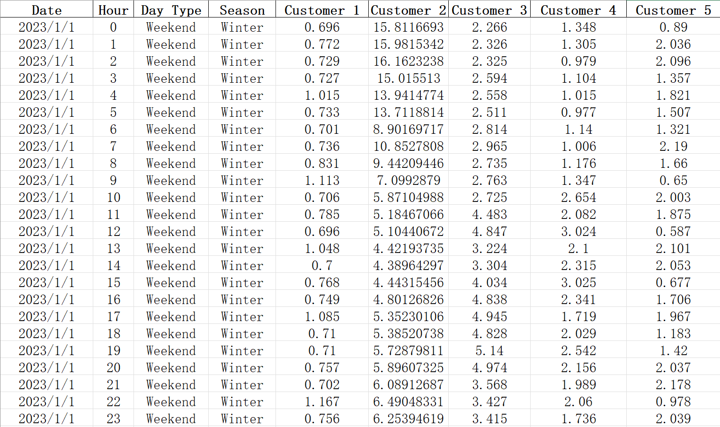
Example Results of DT Load Condition Analysis
Define a penetration level to indicate how many customers have EVs and heat pumps.
Randomly select customers and aggregate EV and heat pump data.
Use the clustering probabilities to assign corresponding EV and heat pump profiles with respect to different seasons and day types (weekdays/weekends).
By running the algorithm over again, the results yield differently.
The example shown here selects a penetration level of 15 customers out of 50.
Aggregated data with EV and heat pump
Showing 5 customers out of 50

Slide 6
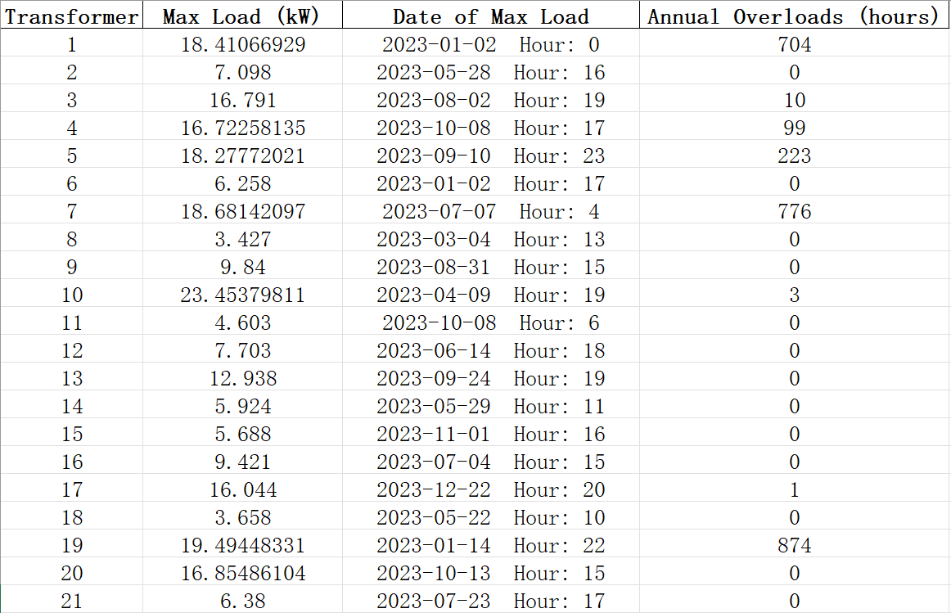
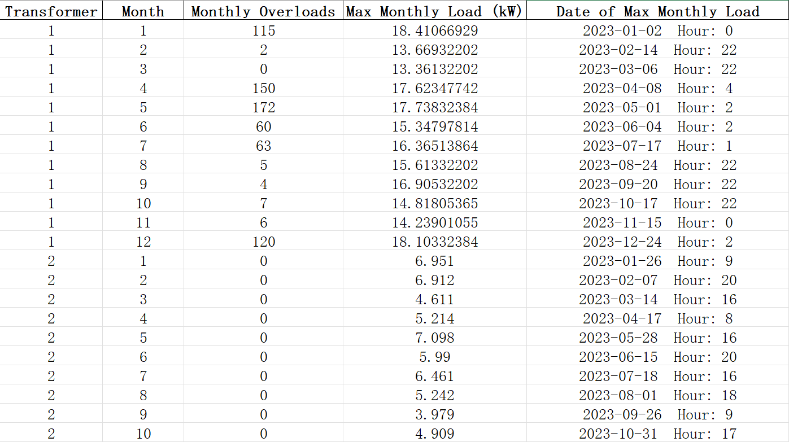
Example Results of DT Load Condition Analysis
Based on the transformer capacity and customer connectivity. After the aggregated data is calculated, the transformer loading condition over a year can be obtained.
The left figure shows the annual peak load, time, and overload counts. The right figure shows monthly break down for each transformer.

Slide 7
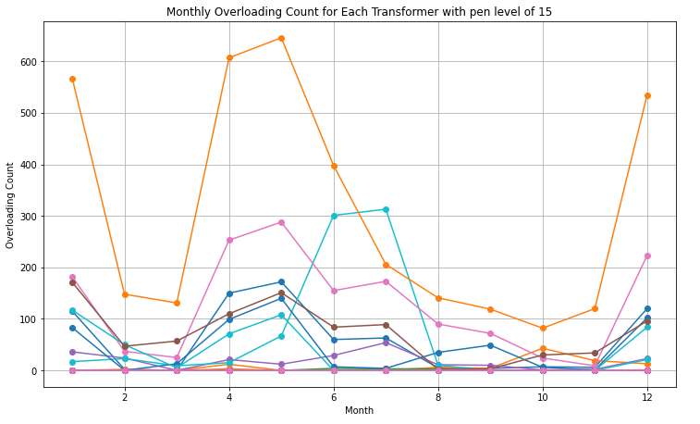
Example Results of DT Load Condition Analysis

